Slide 1
Medicare Data – Visualization and Diagnostic inference
Oct 6, 2014
Velina Lee

Slide 2
Data Source and Hypothetical Problem
Data source: https://data.medicare.gov/, library(nutshell), medicare.payments dataset
Problem: Visualize medicare payments and draw meaningful conclusions
Validate conclusions with healthcare professionals

Slide 3
High Level Description of Data Set
140722 obs. of 14 variable
[1] "Provider.Number" "Hospital.Name" [3] "Address.1" "Address.2" [5] "Address.3" "City" [7] "State" "ZIP.Code" [9] "County.Name" "Phone.Number" [11] "Diagnosis.Related.Group" "Medicare.Average.Payment"[13] "Number.Of.Cases" "Footnote"
70 diagnosis
[1] Acute myocardial infarction, discharged alive w/o CC/MCC
[2] Acute myocardial infarction, discharged alive w MCC
[3] Acute myocardial infarction, discharged alive w CC
[4] Heart failure and shock w/o CC/MCC
[5] Heart failure and shock w MCC
[6] Heart failure and shock w CC
[7] Chronic obstructive pulmonary disease w/o CC/MCC
[27] Perc cardiovasc proc w drug-eluting stent w/o MCC
[28] Laparoscopic cholecystectomy w/o c.d.e. w/o CC/MCC
[29] Laparoscopic cholecystectomy w/o c.d.e. w MCC
[30] Laparoscopic cholecystectomy w/o c.d.e. w CC
[45] Back and neck proc exc spinal fusion w CC/MCC or disc device/neurostim
[46] Bilateral or multiple major joint procs of lower extremity w MCC
[47] Major joint replacement or reattachment of lower extremity w/o MCC
[48] Major joint replacement or reattachment of lower extremity w MCC
[49] Revision of hip or knee replacement w/o CC/MCC
6 variables and 6286 observations:
[1] "Provider.Number" "City" [3] "State" "Diagnosis.Related.Group" [5] "Medicare.Average.Payment" "Number.Of.Cases"

Slide 4
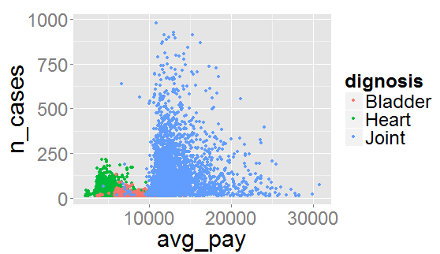
Plot The Data

Slide 5
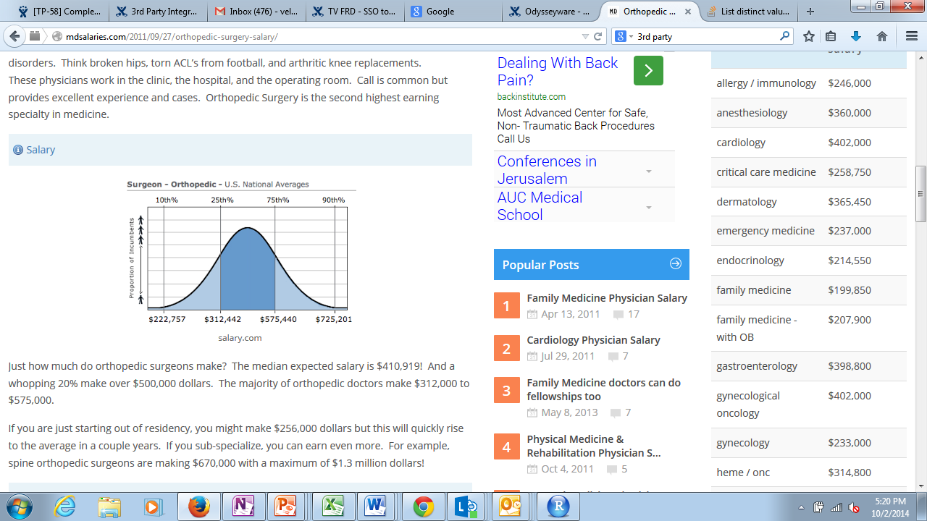
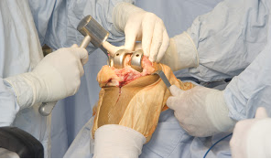
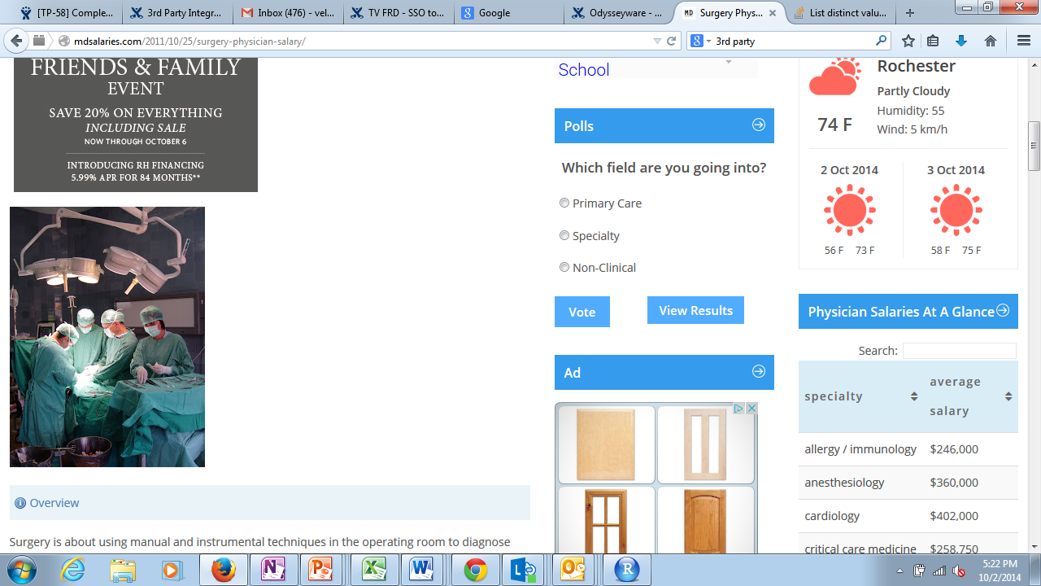
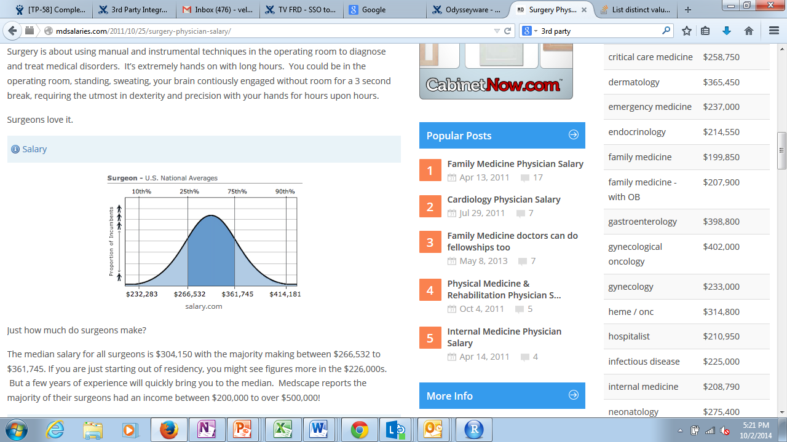
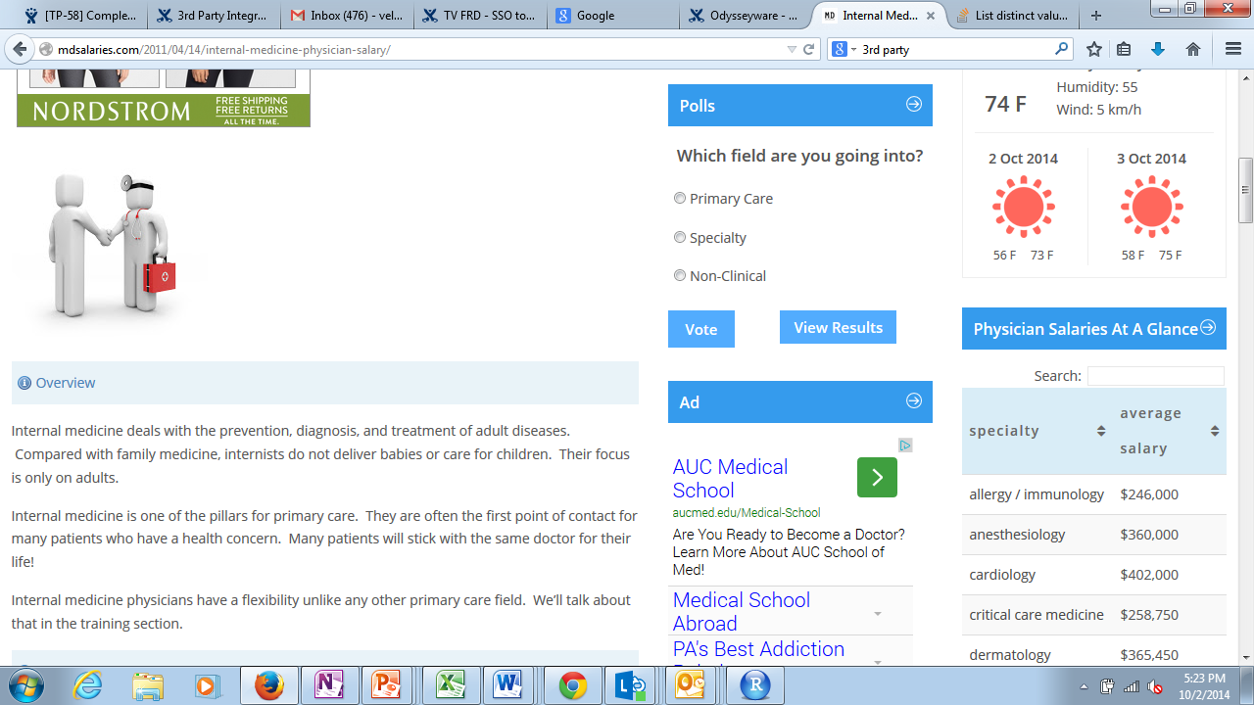
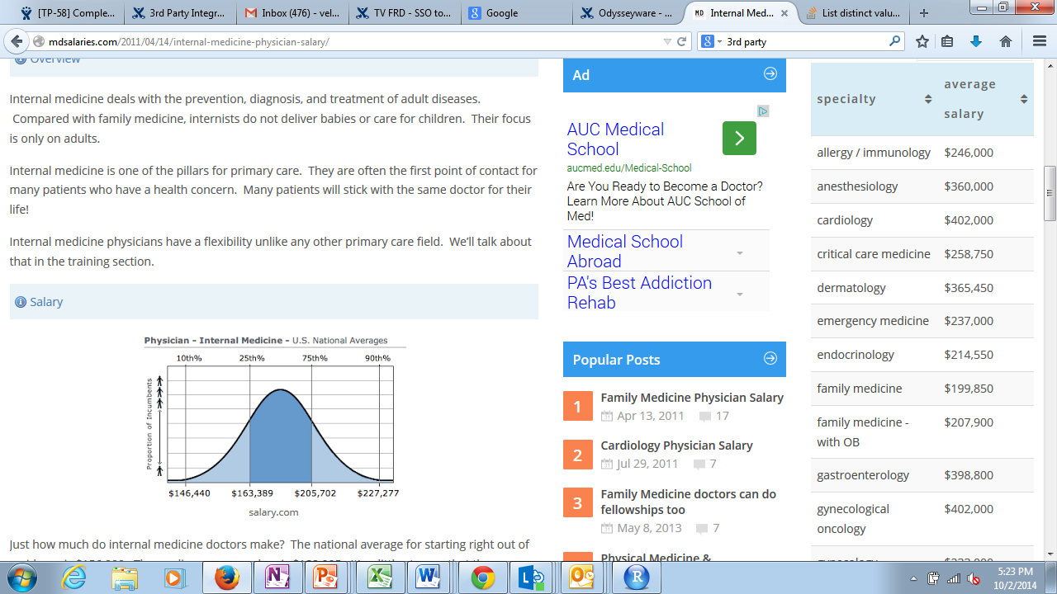
Compare Physician’s Salary by Specialty
Orthopedic Surgeon
General Surgeon
Primary Care

Slide 6
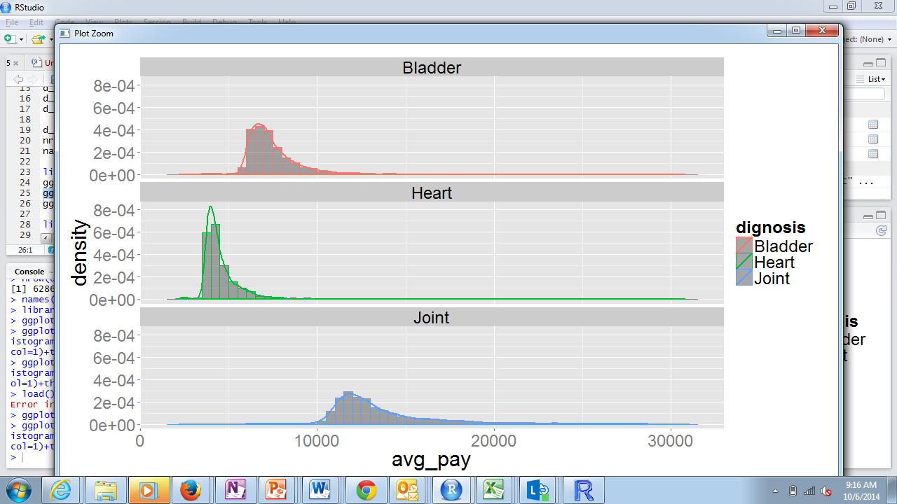
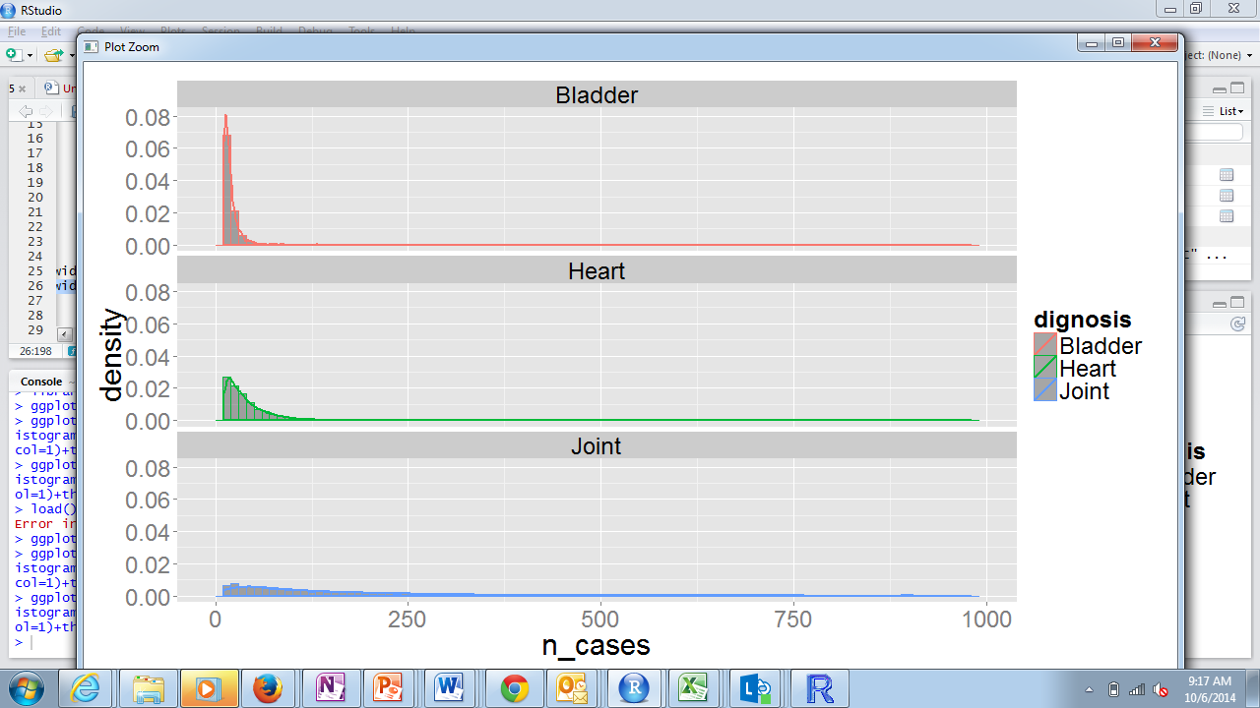
Further Data Visualization – Density Plots

Slide 7
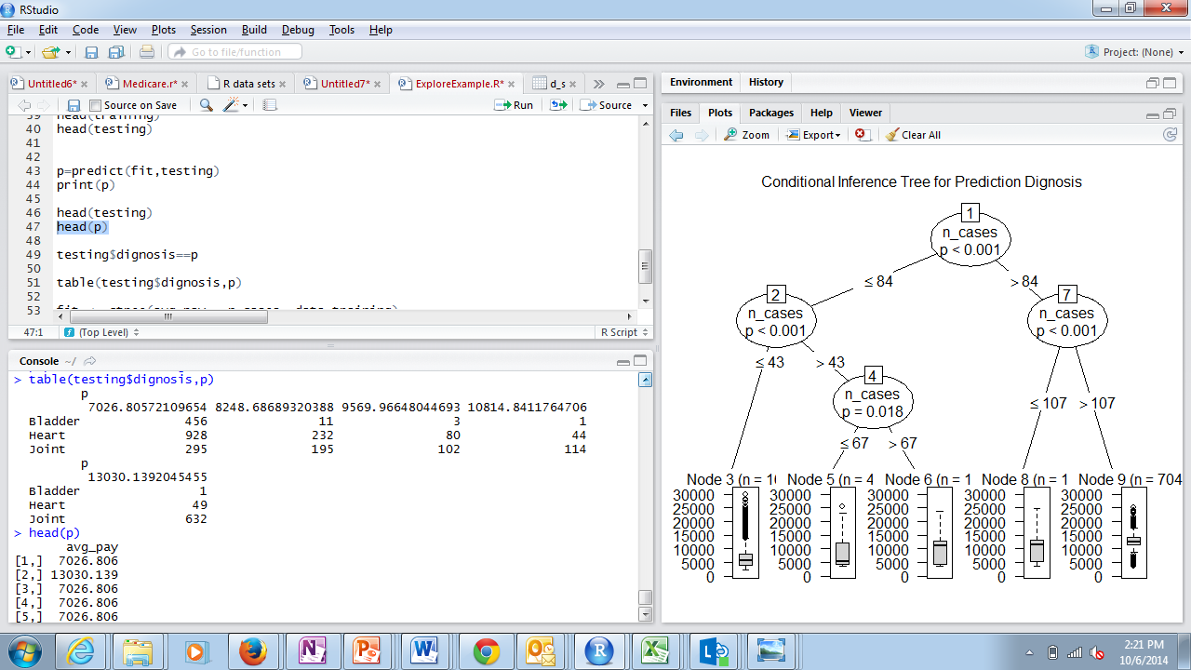
Applying Classification Using “Party” Package
Run “predict” function on test data:
Compare predicted results with actual data

Slide 8
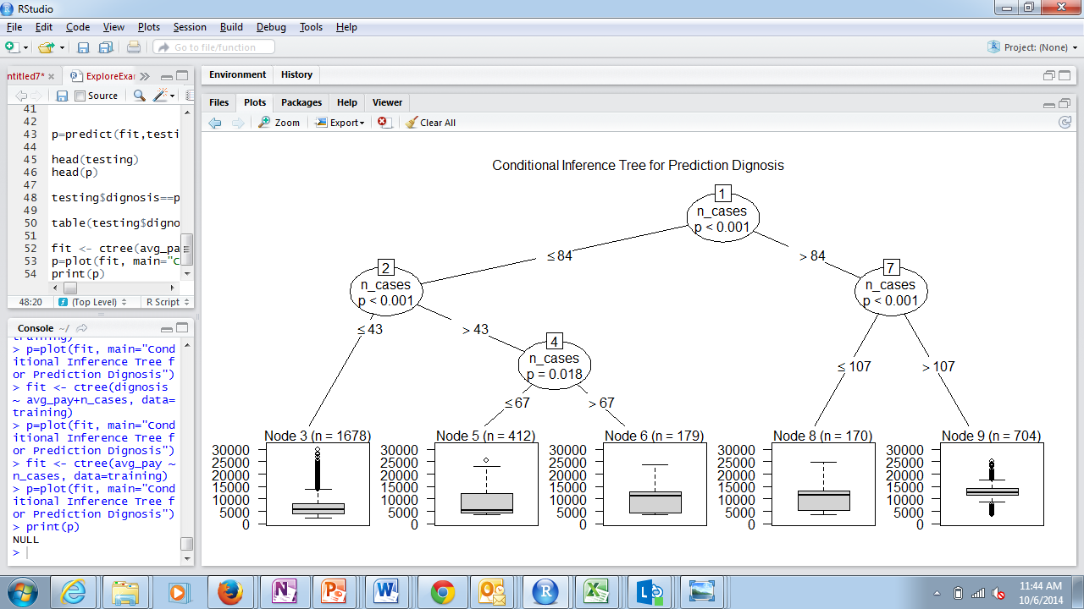
Run a Decision Tree Model for Diagnosis Prediction

Slide 9
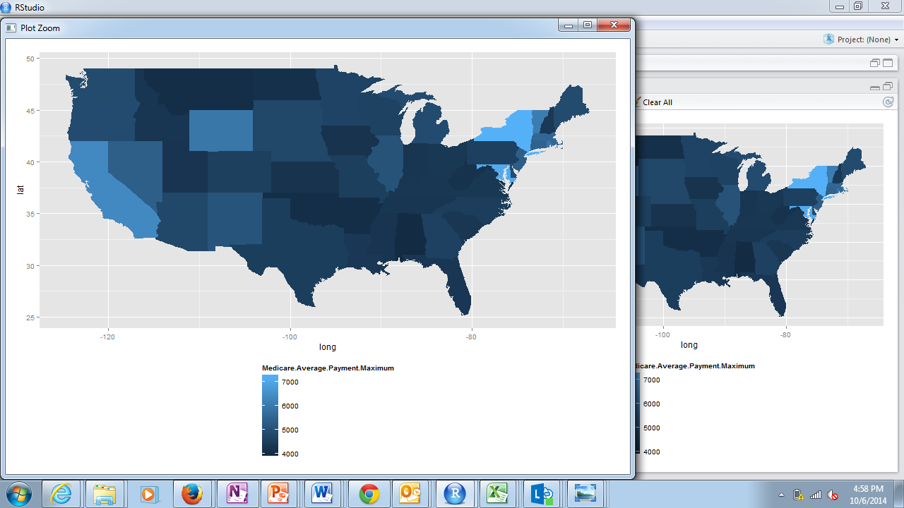
Plot Medicare Payments per State

